Slide 1

Modeling and Monitoring social media dynamics to predict short-term peak electricity demand
Isabella Nunes Grieser, T. Gebhard, A. Tundis, J. Kersten, T. Elßner, F. Steinke

Slide 2
Contents
Motivation
Methodology
Modeling the Impact of Social Media on Power Demand
Estimation Algorithm for the Information Spread with Social Media Data
Case Study: Social Media Misinformation Risks in Dynamic Energy Pricing
Conclusion

Slide 3
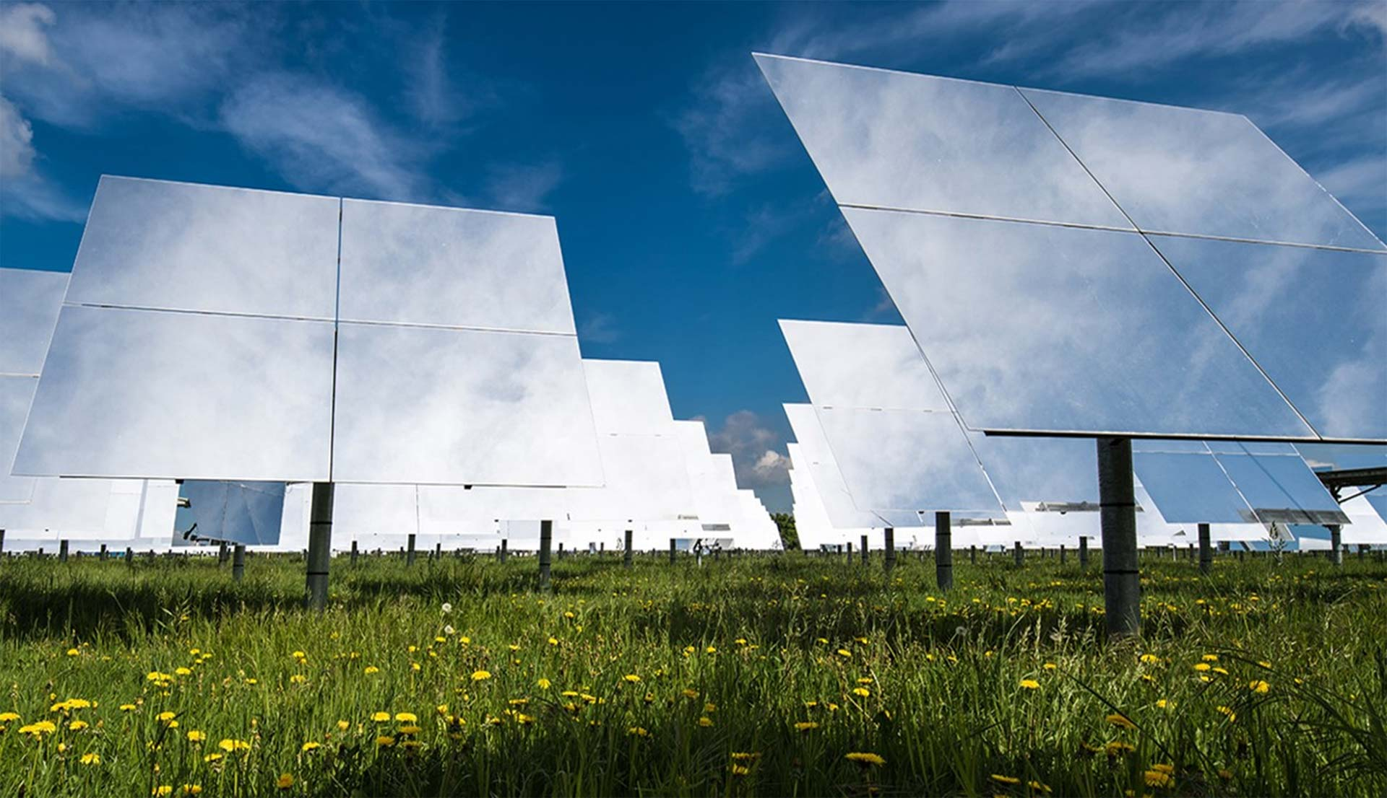
Motivation
Bildquelle hier angeben

Slide 4
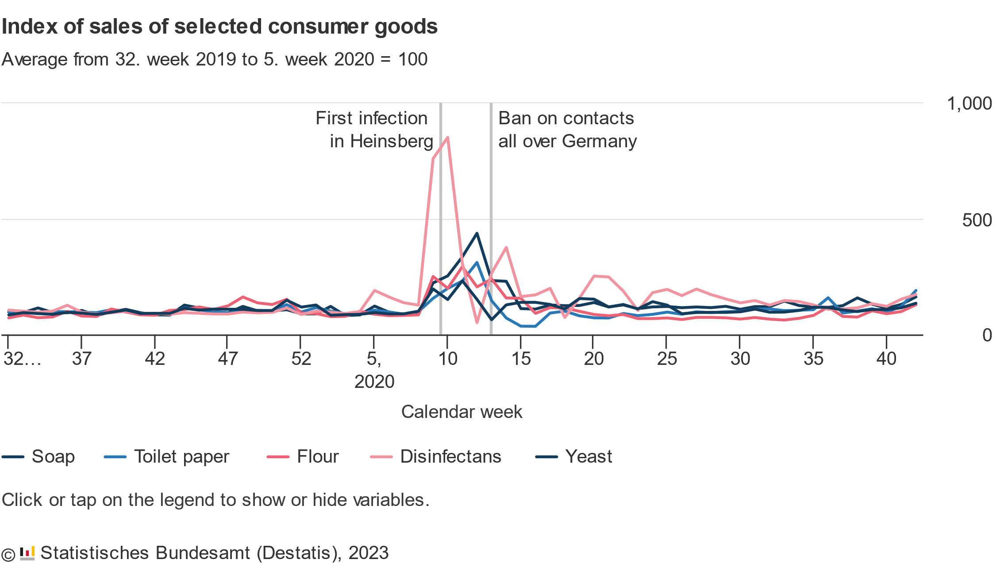
Panic Buying and Overconsumption became a prominent topic during the COVID-19 Pandemic
Panic Buying: When consumers buy unusually large amounts of a product due to a (perceived) crisis
During the COVID-19 Pandemic: People bought much greater number of disinfectants and soap in fear of the infectious disease.
Panic was amplified due to Information on Social Media
4
Federal Statistical Office of Germany (Destatis), 2023

Slide 5


One Example Scenario where Information on Social Media could affect Power Demand
Demand Response Scenario:
Malicious actors compromise the social media channels of an electricity company
spread the false advertisement of reduced electricity prices for a limited time
However: other scenarios could be imagined…

Slide 6

Proposal for a Monitoring Framework
Monitoring Framework:
Collect relevant Social Media Posts
Predict Model Parameters
Run Simulation with the Proposed Model
Predict Critical Peak Electricity Demand Trend
Source: Wikimedia Foundation

Slide 7
Modeling the Impact of Social Media on Power Consumption
Bildquelle hier angeben

Slide 8

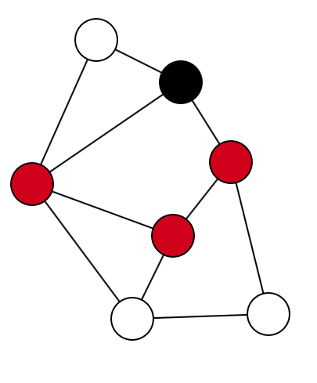
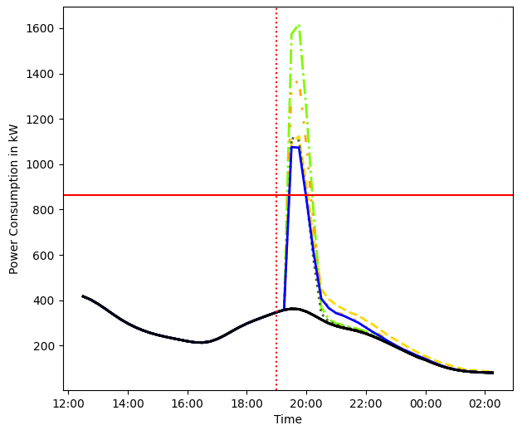
The Model is divided into three Components
Social Media Graph:
Information Propagation Model:
Power Consumption Rules:

Slide 9
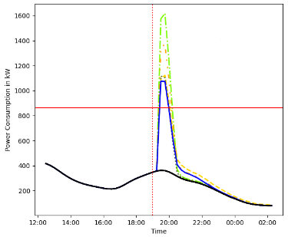
Graph-Based Social Network Modelling and Information Propagation
Graph model used to model social media networks ➔ Barabási–Albert model
Small world
Scale-free networks
Highly clustered
The SIR model is used to model the information propagation process:
Three states:
Susceptible (S)
Infected (I)
Recovered (R)

Slide 10

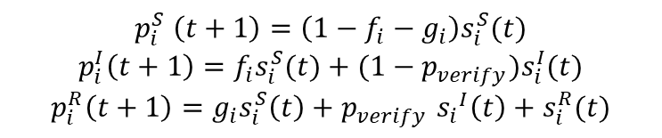





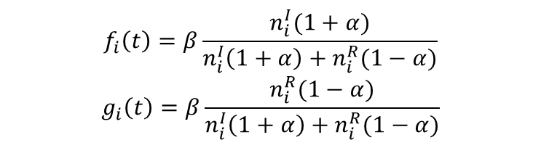
Rule-Based Calculation of the Power Consumption
State Chart:
$${1−g}_{neighbors}−f_{neighbors}$$
Susceptible
$$g_{neighbors}$$
$$f_{neighbors}$$
Recovered
Infected
$$p_{verify}$$
$$1$$
$$1−p_{verify}$$
$$p_{i}^{S} \left(t+1\right)=\left(1−f_{i}−g_{i}\right)s_{i}^{S}(t)$$
$$p_{i}^{I}\left(t+1\right)=f_{i}s_{i}^{S}(t)+(1−p_{verify})s_{i}^{I}(t)$$
$$p_{i}^{R}\left(t+1\right)=g_{i}s_{i}^{S}\left(t\right)+p_{verify} {s_{i}}^{I}\left(t\right)+s_{i}^{R}(t)$$
$$f_{i}\left(t\right)=β\frac{n_{i}^{I}(1+α)}{n_{i}^{I}\left(1+α\right)+n_{i}^{R}(1−α)}$$
$$g_{i}\left(t\right)=β\frac{n_{i}^{R}(1−α)}{n_{i}^{I}\left(1+α\right)+n_{i}^{R}(1−α)}$$

Slide 11
The Model is divided into three Components
Assumptions:
Each node in the social media graph represents one (physical) household
Only infected entities change their electricity demand
The effect of the information may have a delayed response on the electrical grid
Simulation Steps:
Start with one source of information
For each iteration step:
Calculate the power used in the network
Spread the information in the graph

Slide 12
Rule-Based Calculation of the Power Consumption
Power Calculation:
Power usage is computed as the normal power consumption + the additional demand:
Reference power consumption defined with standard load profiles
Each household may have electrical appliances given their adoption rate
Households turn on all relevant electrical appliances
Each appliance consumes a constant amount of energy

Slide 13
Estimation Algorithm for the Information Spread with Social Media Data
Bildquelle hier angeben

Slide 14

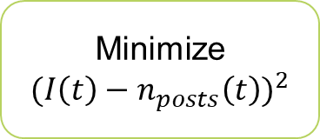
Social Media Data can be used to estimate Model Parameters
Count Social Media Posts over a Timespan
Smooth Data Plot
Minimize
$${(I\left(t\right)−n_{posts}\left(t\right))}^{2}$$
Solve Differential Equations
Differential Equations:
$$\frac{dS}{dt}=−\frac{kβ}{N}∙S(t)$$
$$\frac{dI}{dt}=\frac{kβ}{N}∙\frac{I\left(t\right)\left(1+α\right)}{I\left(t\right)\left(1+α\right)+R\left(t\right)\left(1−α\right)}∙S\left(t\right)−p_{verify}∙I(t)$$
$$\frac{dR}{dt}=\frac{kβ}{N}∙\frac{R\left(t\right)\left(1−α\right)}{I\left(t\right)\left(1+α\right)+R\left(t\right)\left(1−α\right)}∙S\left(t\right)+p_{verify}∙I(t)$$
➔ Solve for $α, β, p_{verify}, S(0), I\left(0\right), R(0)$

Slide 15
CASE STudy
Bildquelle hier angeben

Slide 16
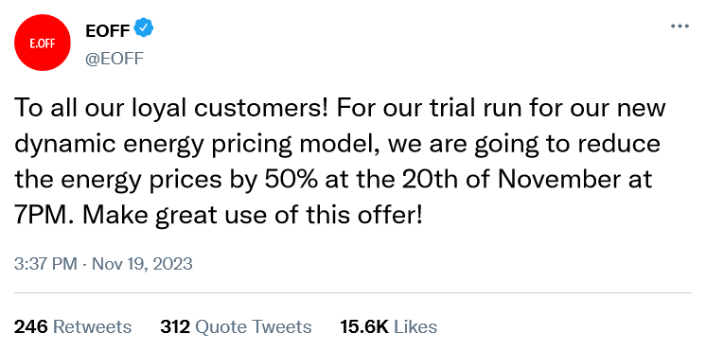
One Example Scenario where Information on Social Media could affect Power Demand
Assumptions:
Many people believe and will act on the information
Infected entities have a delayed response, acting after the time specified in the social media message
Infected entities will turn on most energy-intensive appliances (dishwasher, washing machine, …) in their households
Number of entities: 1000, time resolution: 30 minutes
Demand Response Scenario:
Malicious actors compromise the social media channels of an electricity company
spread the false advertisement of reduced electricity prices for a limited time

Slide 17
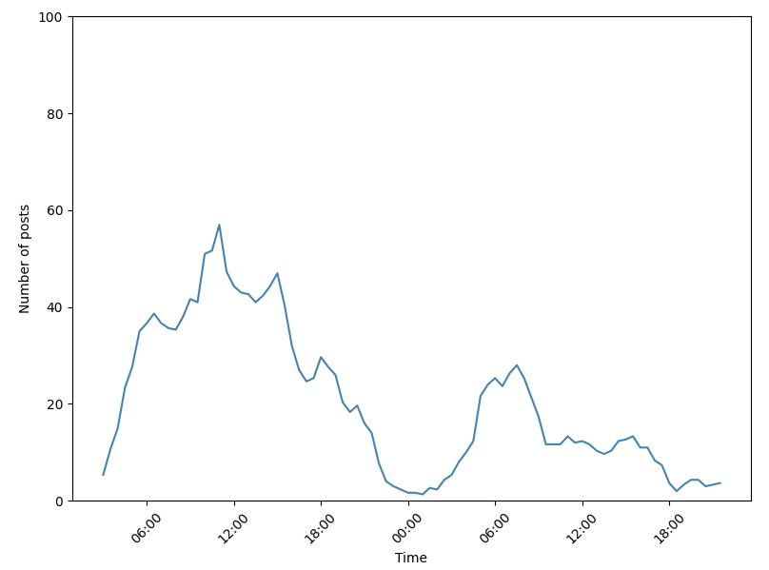
Idea: Use similar, but unrelated information propagation event dataset to estimate realistic model parameters
Social Media Dataset:
Grunewald fire: Fire caused by an explosion in Grunewald, Berlin on August 4th, 2022
Posts contained the keywords ” Grunewald”, ”fire”, ”explosion”, or ”bomb”
Twitter posts and their timestamps gathered between August 4th, 2022, and August 5th, 2022
In total: 1759 tweets
Tweets were aggregated to count the number of tweets every 30 minutes
moving average filter was used to smooth the information propagation plot
Information propagation progress over time for the Grunewald dataset

Slide 18
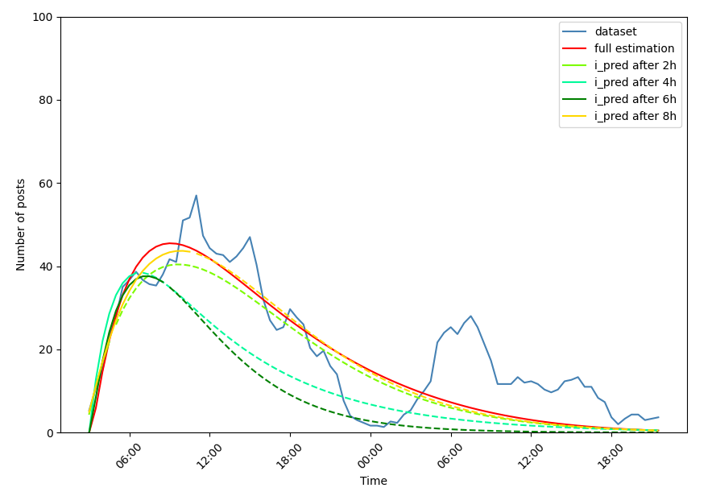
Idea: Use similar, but unrelated information propagation event dataset to estimate realistic model parameters
Parameter estimation results with variable data input size

Slide 19
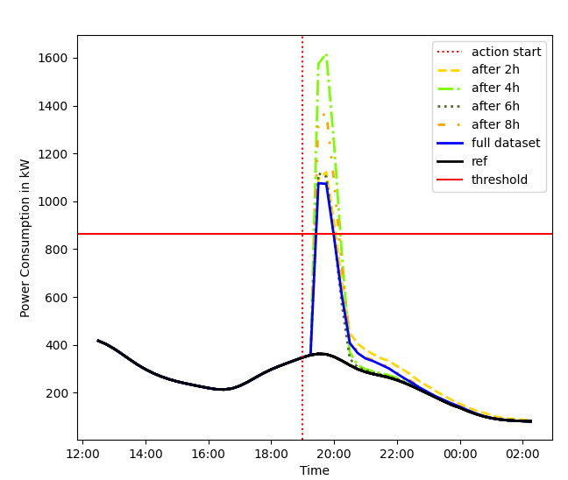
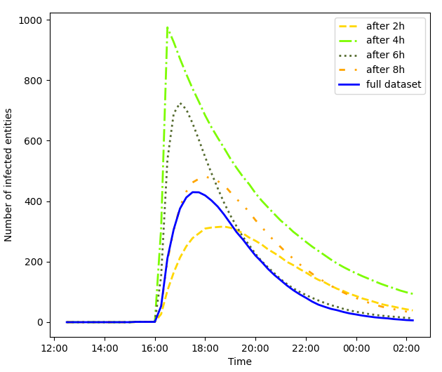
Simulated Infection Process and Power Consumption
Simulated excess power consumption for different estimated information propagation parameters
Simulated infections process for different estimated information propagation
parameters

Slide 20
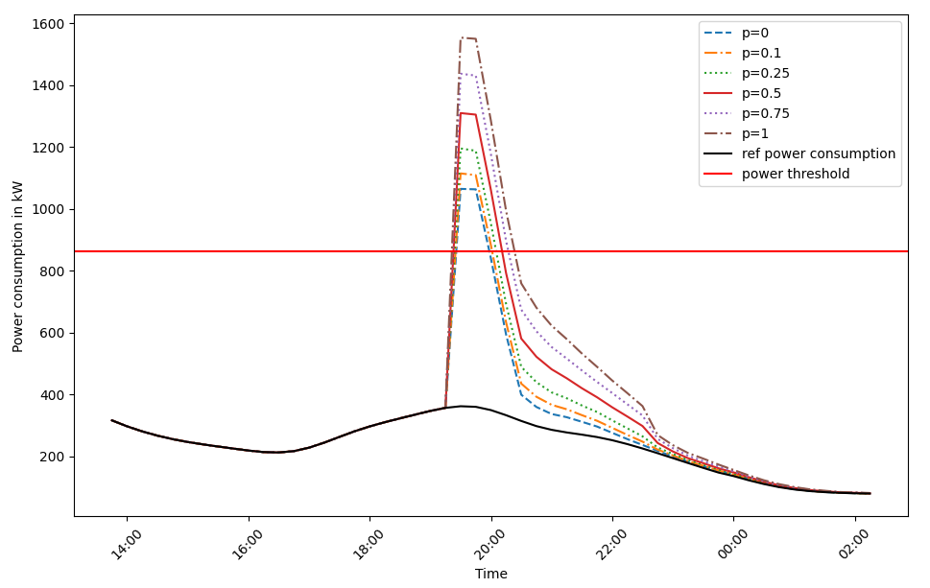
Changes in Power Consumption with a variable adoption rate for EVs
Results of the simulation model with different adoption rates p for EVs

Slide 21
Conclusion
Bildquelle hier angeben

Slide 22
Conclusion
Summary:
This paper proposed a framework to monitor the effects of information on the power grid.
Model to simulate the impact of information on the power grid
Algorithm to estimate information propagation parameters
Application of our framework on a theoretical scenario
Usage of similar, but unrelated dataset to analyze our framework
Grid operators and other relevant entities could use our framework to predict critical power consumption peaks caused by information on social media in advance
Results:
Synchronization events caused by information on social media could be critical for the power grid
Increasing adoption of new, highly power-consuming technologies could increase the peak power demand caused by synchronization
Our proposed framework was able to estimate the spread of information successfully, even when the information spread was still ongoing

Slide 23
Conclusion
Future Works:
Analysis of methods to collect relevant social media posts
Natural language processing techniques
Search engine trends
Analysis of countermeasures for changes in power demand based on information on social media
Currently, only reactive measures, such as load shedding, are considered
Preemptive countermeasures to prevent removal of consumers from the power grid

Slide 24
QuestionS?
Bildquelle hier angeben

